Slide 1
Sustaining Inquiry in Project Based Learning
Personalizing PBL using Inquiry Based Strategies
Brian Anton
BASocialStudies.weebly.com
Twitter: @FHS_Anton & @EDge_Innovative
Facebook: www.facebook.com/InnovativeEDgeU/
E-mail: anton6984@gmail.com
Forsyth High School & Innovative EDge Consulting

Slide 2
What is Project Based Learning (PBL)?
“Project Based Learning is a teaching method in which students gain knowledge and skills by working for an extended period of time to investigate and respond to an engaging and complex question, problem, or challenge.” (Buck Institute for Education)
“Project Based Learning is a dynamic classroom approach in which students actively explore real-world problems and challenges and acquire a deeper knowledge” (Edutopia)

Slide 3
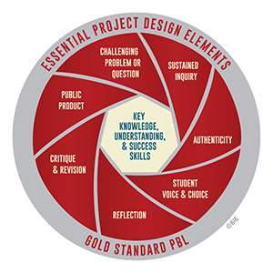
Essential Elements/Characteristics of Project Based Instruction
“Gold Standard PBL:” Buck Institute for Education
“5 Characteristics of Project Based Learning That Works:” TeachThought

Slide 4
Why Use Inquiry Based Strategies?
Provides learners with a voice through the opportunity to develop their own learning framework.
Learners become stakeholders, leading to higher engagement.
Provides opportunities for personalization of learning by increasing the amount of choice in students’ direction of study.
Authentic Higher Order Learning--Learners develop divergent and convergent thinking skills.
See: “Inspired Issue Brief: Inquiry Based Teaching” http://inspiredteaching.org/wp-content/uploads/impact-research-briefs-inquiry-based-teaching.pdf

Slide 5
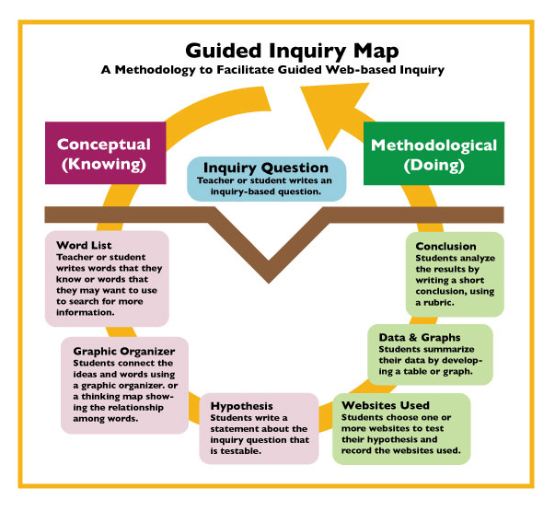
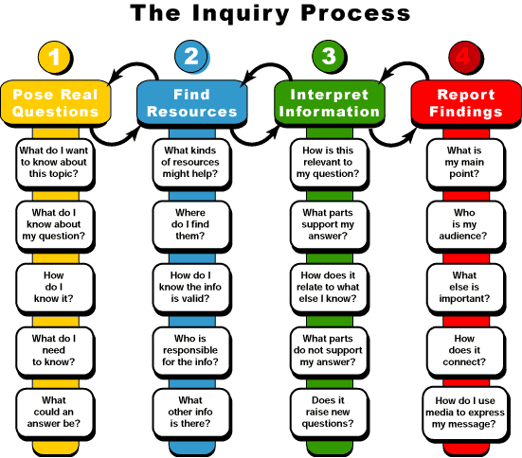
The Inquiry Process

Slide 6
Beginning a Unit: Teaching Students How to Ask Quality Questions
Introduce the Question Formulation Process and the Rules for Questioning:
Ask as many questions as you can.
Do not stop to judge, discuss, or answer questions.
Write down every question exactly as stated.
Change any statement into a question.
Source: Right Question Institute (rightquestion.org)

Slide 7
Beginning a Unit: Teaching Students How to Ask Quality Questions
In groups of two or three:
Ask as many questions as you can (do not restate the focus statement as a question).
Do not stop to judge, discuss, or answer questions.
Write down every question exactly as stated.
Change any statement into a question.
Question Focus: “The ideas put into the Constitution by the delegates at the Constitutional Convention were original.”
Goal: Through research, prove or disprove the Question Focus statement using primary sources.
Source: Right Question Institute (rightquestion.org)

Slide 8
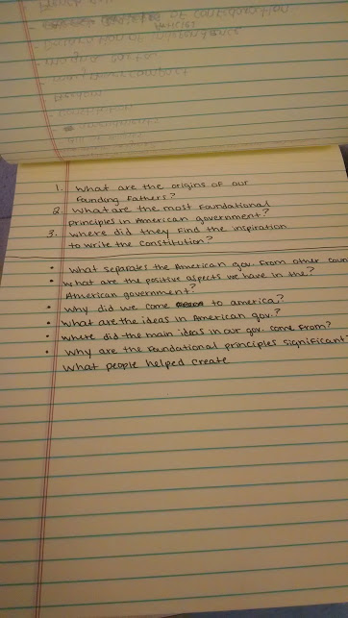
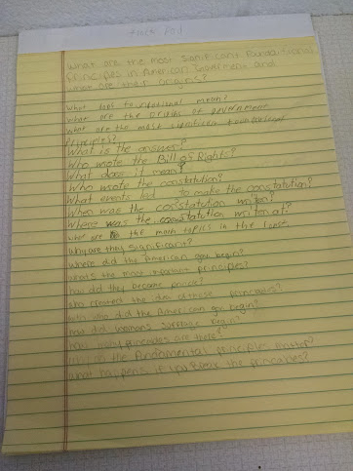
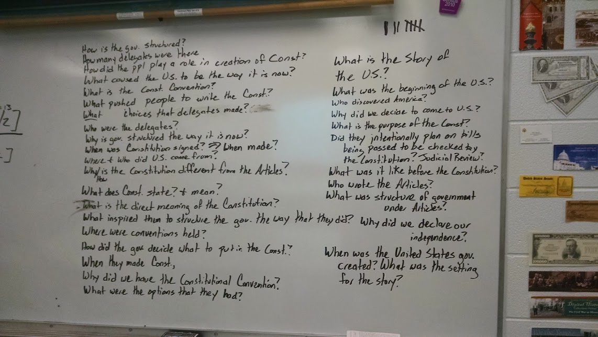
Beginning a Unit: Teaching Students How to Ask Quality Questions

Slide 9
Beginning a Unit: Teaching Students How to Ask Quality Questions
Discussion: What makes a quality research question?
Evaluate your questions using a 1-5 scale (1=least beneficial-5=most beneficial)
Identify the five most beneficial questions to begin research and write them EACH on a sticky note.
Hang your five sticky notes/questions on the wall.
In your groups, evaluate ALL of the questions on the wall, then decide on the THREE most beneficial research questions

Slide 10
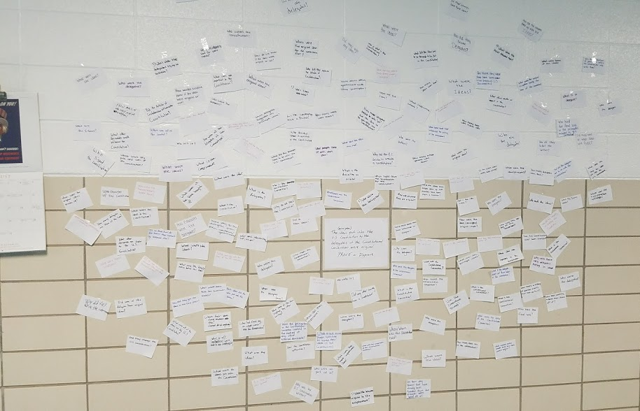
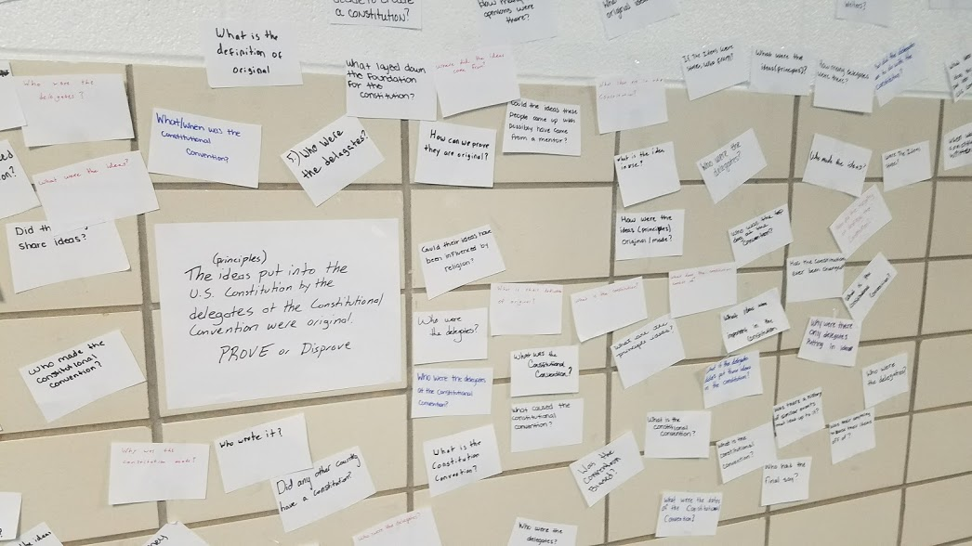
Beginning a Unit: Teaching Students How to Ask Quality Questions
Question Focus: “The ideas put into the Constitution by the delegates at the Constitutional Convention were original.” Goal: Through research, prove or disprove the Question Focus statement using primary sources.

Slide 11
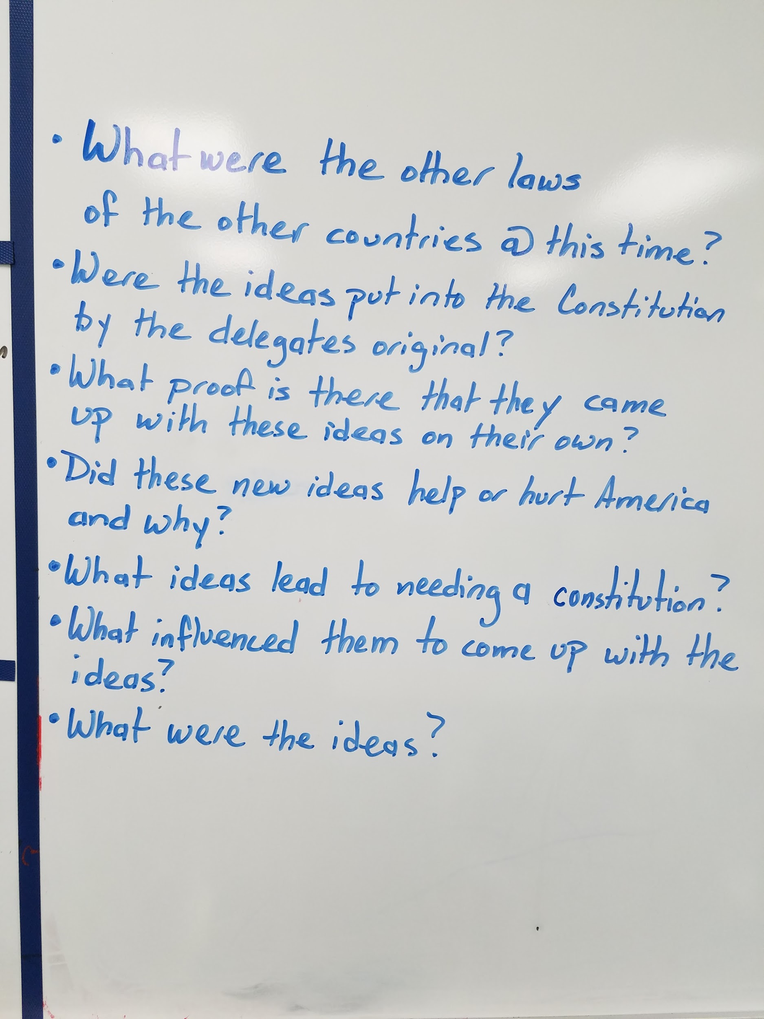
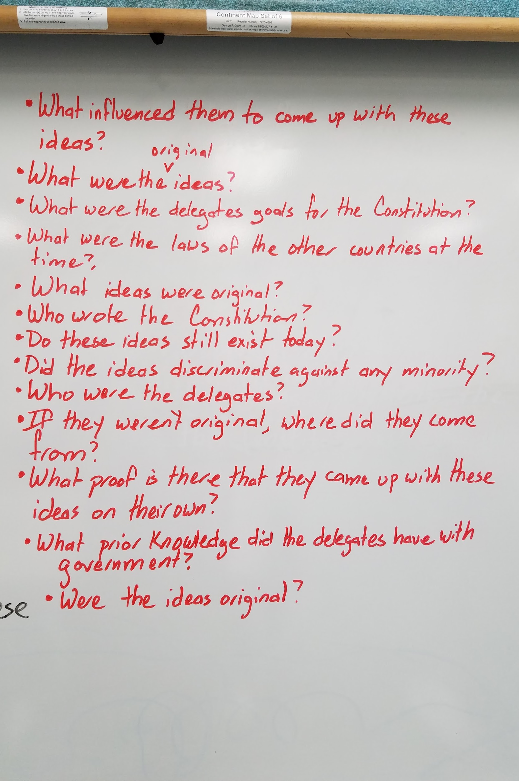
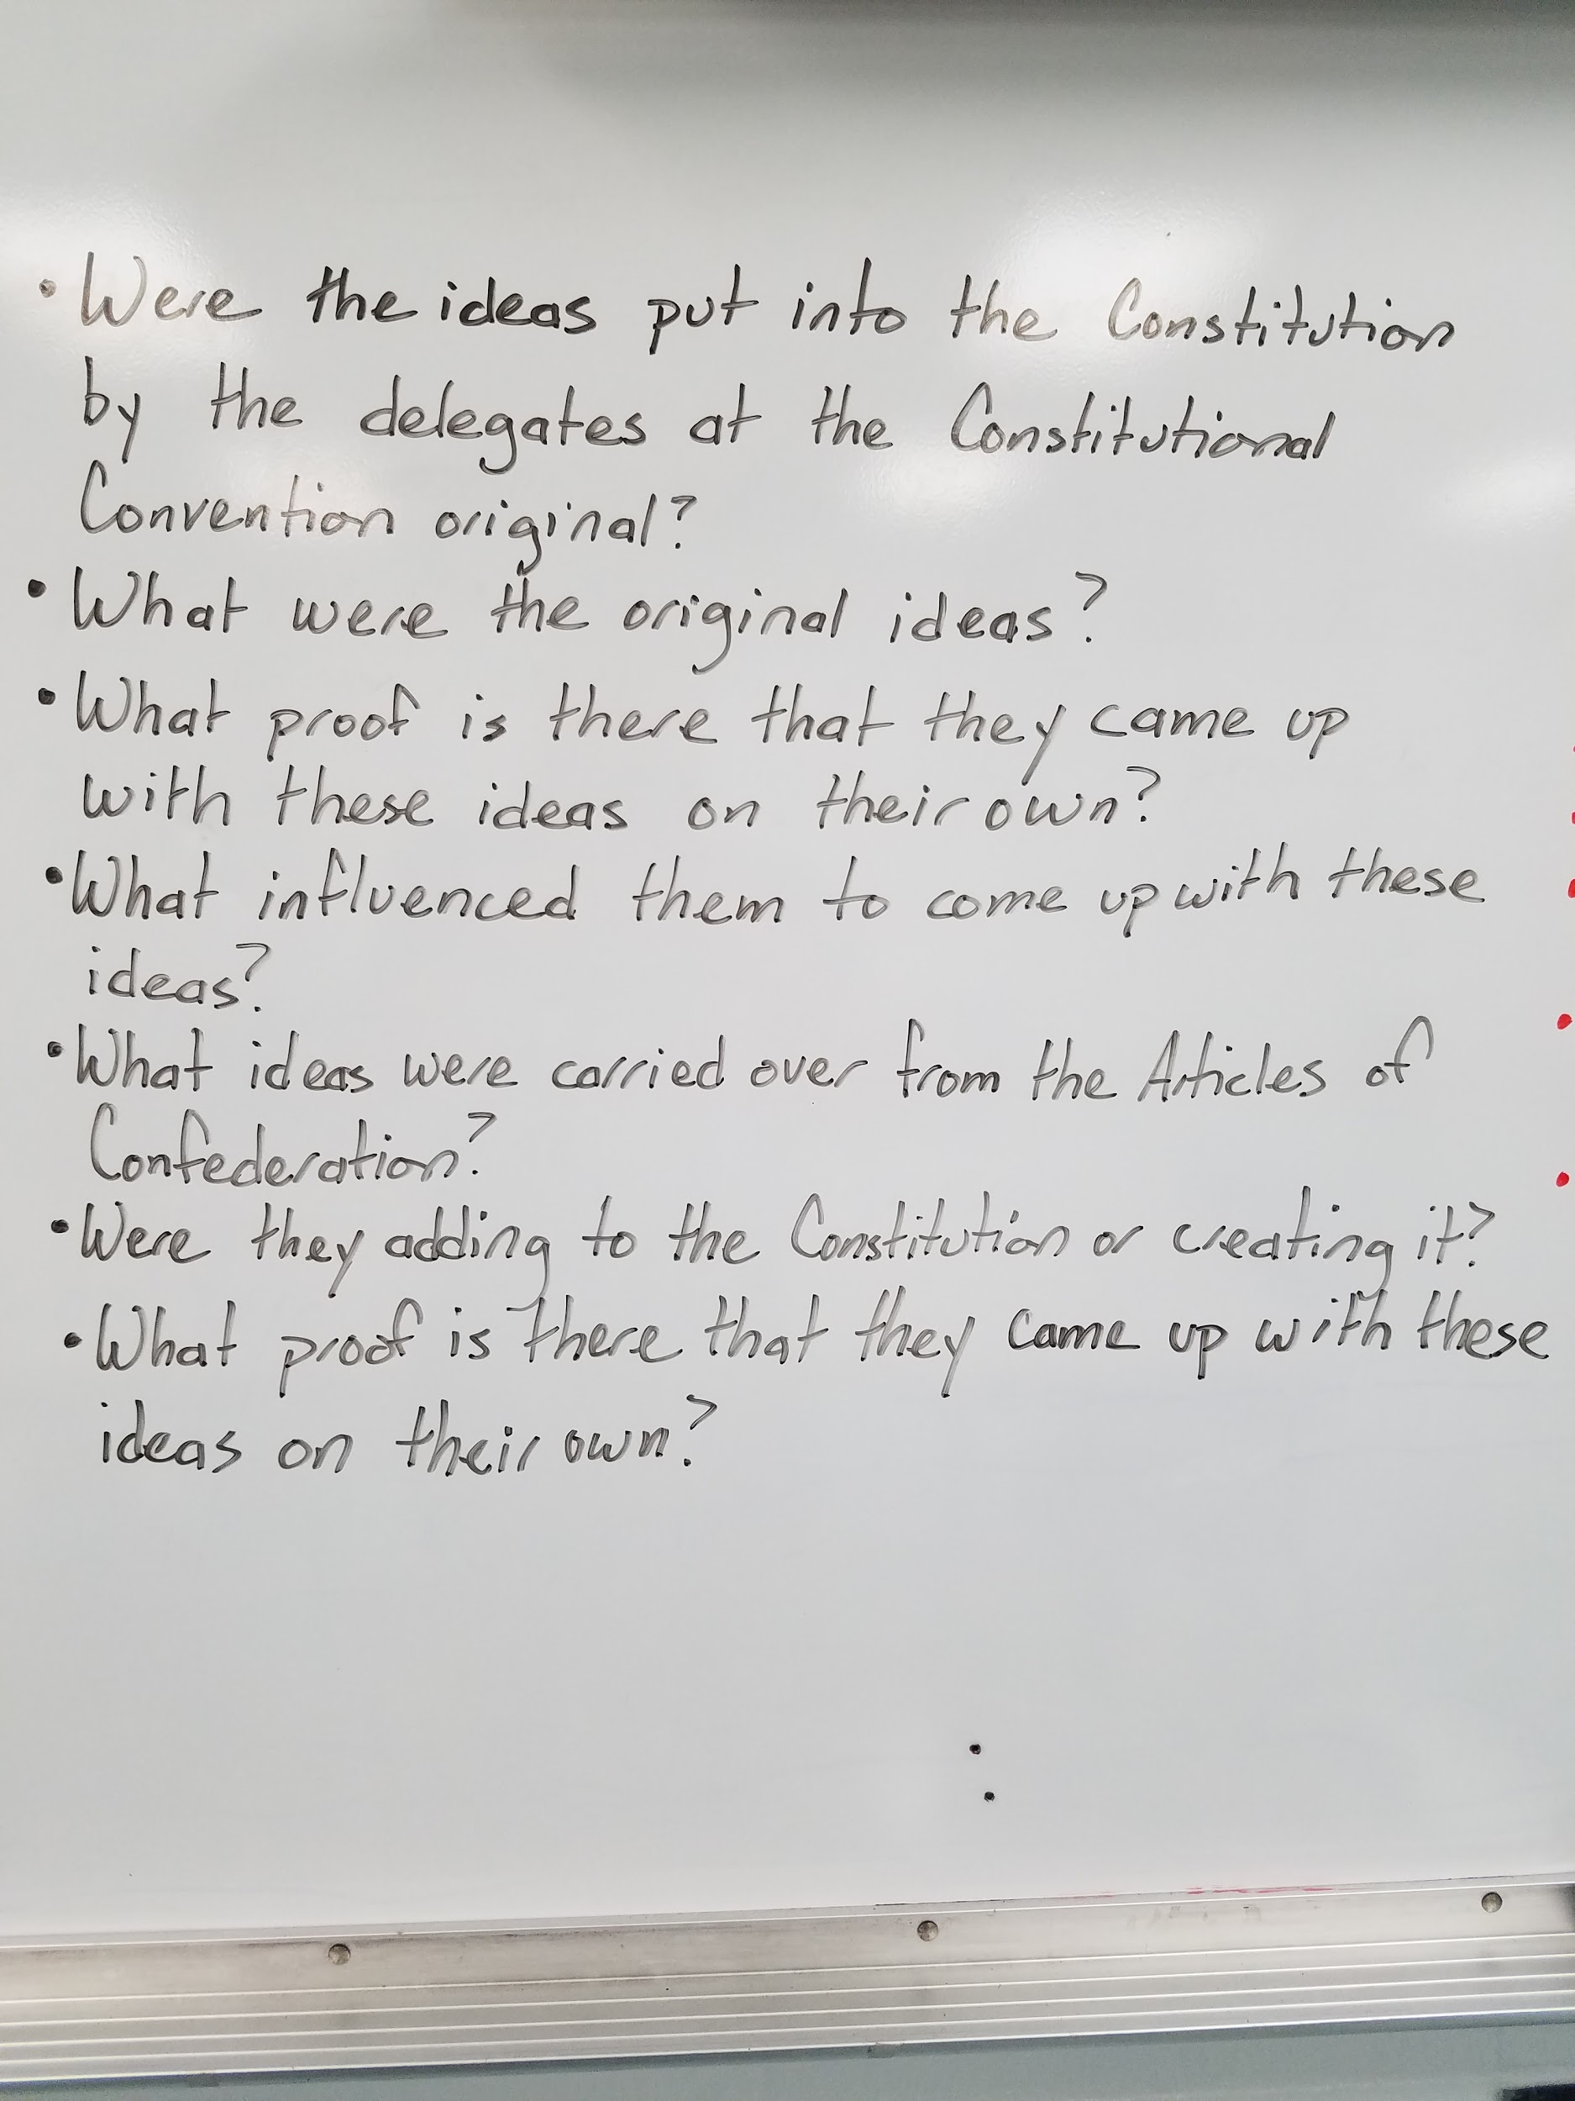
Beginning a Unit: Teaching Students How to Ask Quality Questions

Slide 12
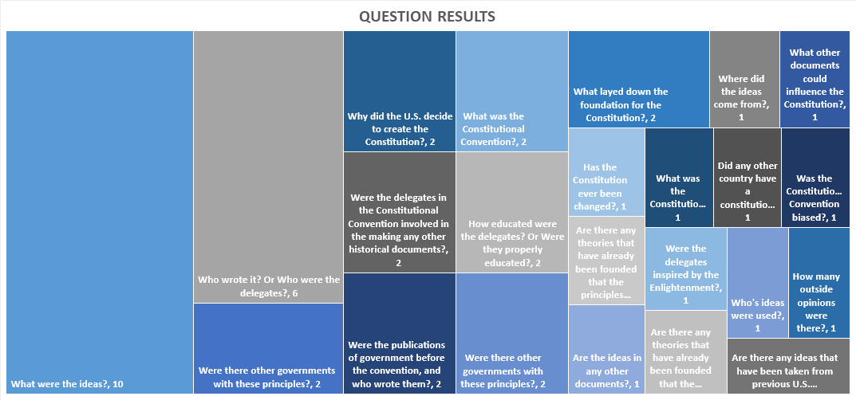
Beginning a Unit: Teaching Students How to Ask Quality Questions

Slide 13
Moving Forward: Sustaining Inquiry
Open: bit.ly/inquirydoc1
Make a Copy & Share with Group Members

Slide 14
Moving Forward: Sustaining Inquiry
Open: bit.ly/inquirydoc2
Make a Copy & Share with Group Members

Slide 15
Moving Forward: Sustaining Inquiry
Open: bit.ly/inquirydoc4
Make a Copy & Share with Group Members

Slide 16
Developing an Essential Question or “Question Focus” To Drive Your Unit

Slide 17
Sustaining Inquiry in Project Based Learning
Personalizing PBL using Inquiry Based Strategies
Brian Anton
BASocialStudies.weebly.com
Twitter: @FHS_Anton & @EDge_Innovative
Facebook: www.facebook.com/InnovativeEDgeU/
E-mail: anton6984@gmail.com
Forsyth High School & Innovative EDge Consulting

